Slide 1
Memory Design And Testing
4x4 Open Digit Line DRAM
Team Members: Arjun Sheshadri - PES1201701137 Likhith Kumar Shetty - PES1201701337

Slide 2
Open Digit line DRAM
Open Digit line DRAM differs from a normal DRAM only in the location of the Sense Amplifier.
In open digit line DRAM between rows of memory the sense amplifier is placed this helps in reducing the length of the Digit line hence reducing the capacitance which results in better charge and discharge times.

Slide 3
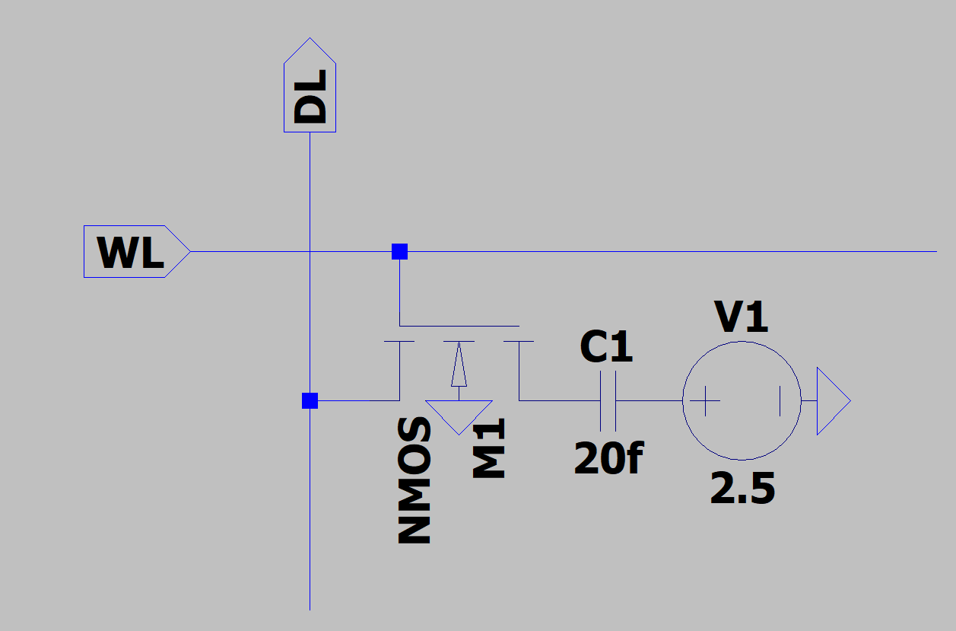
DRAM 1T-1C cell
This cell uses a nMOS transistor and will theoretically require the word line to be higher than Vdd to store a ‘1’ in the cell.
The Read operation from this cell causes the digit line to change it only by a small portion called as Vsignal to pull this to the rail voltage we need the Sense Amplifier

Slide 4
Sense Amplifier
The Sense Amplifier in a DRAM consists of multiple Components, these are:
Equilibrate and Bias Circuit
Isolation circuit
N-sense
P-sense
I/O Control

Slide 5
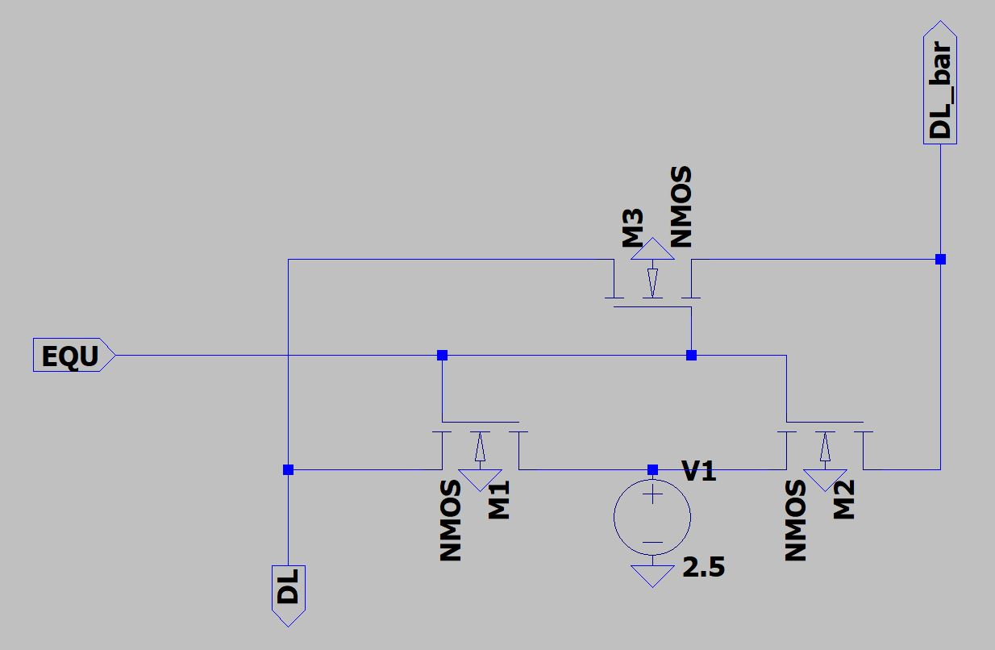
Equilibrate and Bias Circuit
Before any data is read or written to the memory cell the digit line must be kept at an equal voltage if Vdd/2.
The transistors M1,M2 pass the Vdd/2(2.5 in this case) voltage to both the digit lines used to compare
The transistor M3 is used to prevent false read if the transistors M1 & M2 are not able to provide equal voltage to both digit lines

Slide 6
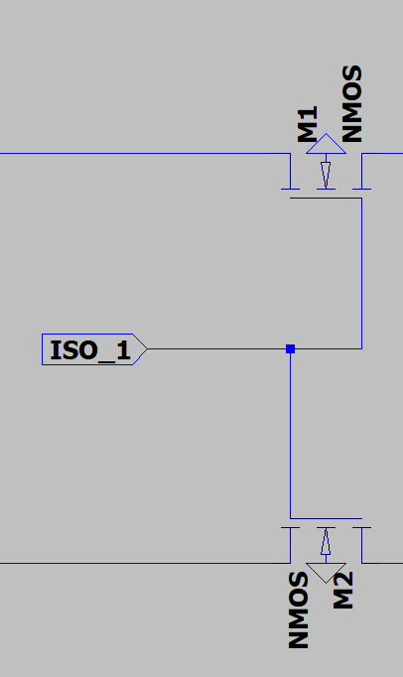
Isolation circuit
Isolation circuit is used to flot the digit lines just before the Read or Write operation to the cell
The Pre-charging and the voltages should be disconnected so that the effects on the digit line due to the cell can be observed.

Slide 7
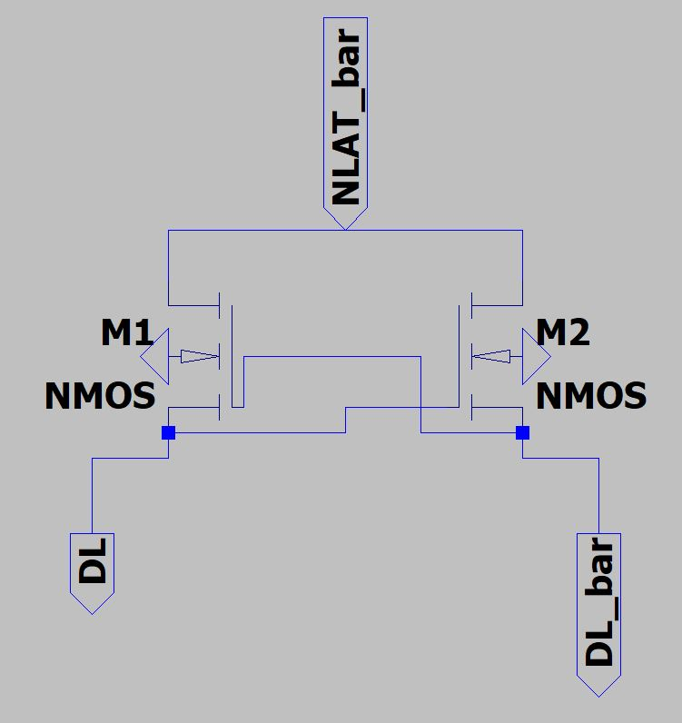
N-sense
The operation of the N-sense is mainly controlled by the NLAT and digit line signals
During the Read operation any one of the digit lines will go high or low based on the memory in cell simultaneously the NLAT signal starts reducing the value from initial Vdd/2 to 0 slowly this will cause the Digit line to fall to 0 following the NLAT signal.

Slide 8
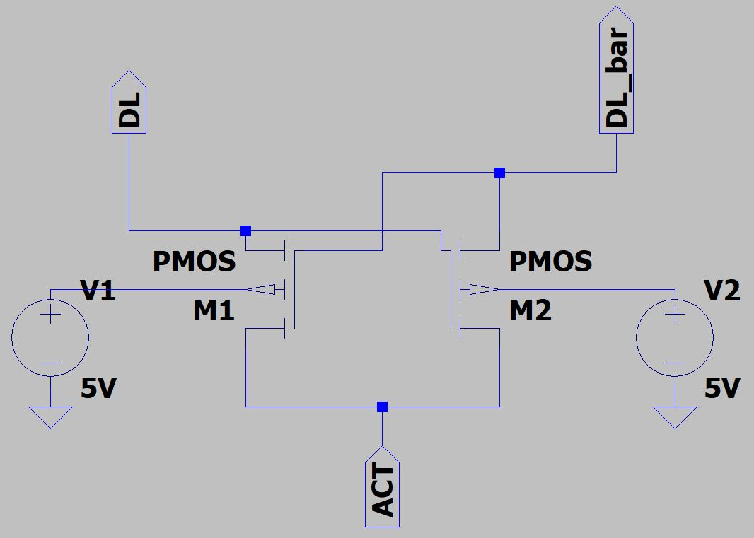
P-sense
The operation of the P-sense is mainly controlled by the ACT and digit line signals
During the Read operation any one of the digit lines will go high or low based on the memory in cell simultaneously the ACT signal starts increasing it’s value from initial 0 to Vdd slowly this will cause the Digit line(whose voltage increasing) to raise to the rail voltage.

Slide 9
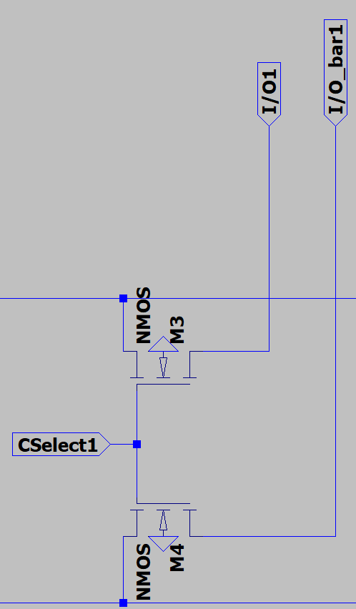
I/O Control
The output of the write driver circuit is connected to I/O and I/O_bar signals
The cselect for the respective column in which the value is to be written is turned on.
This in turn Enables the M3 and M4 transistors passing the output of Write driver circuit to the digit line
This signal is effected by the pass transistors of the isolation circuit so the sense amplifier helps pull it back to Vdd the

Slide 10
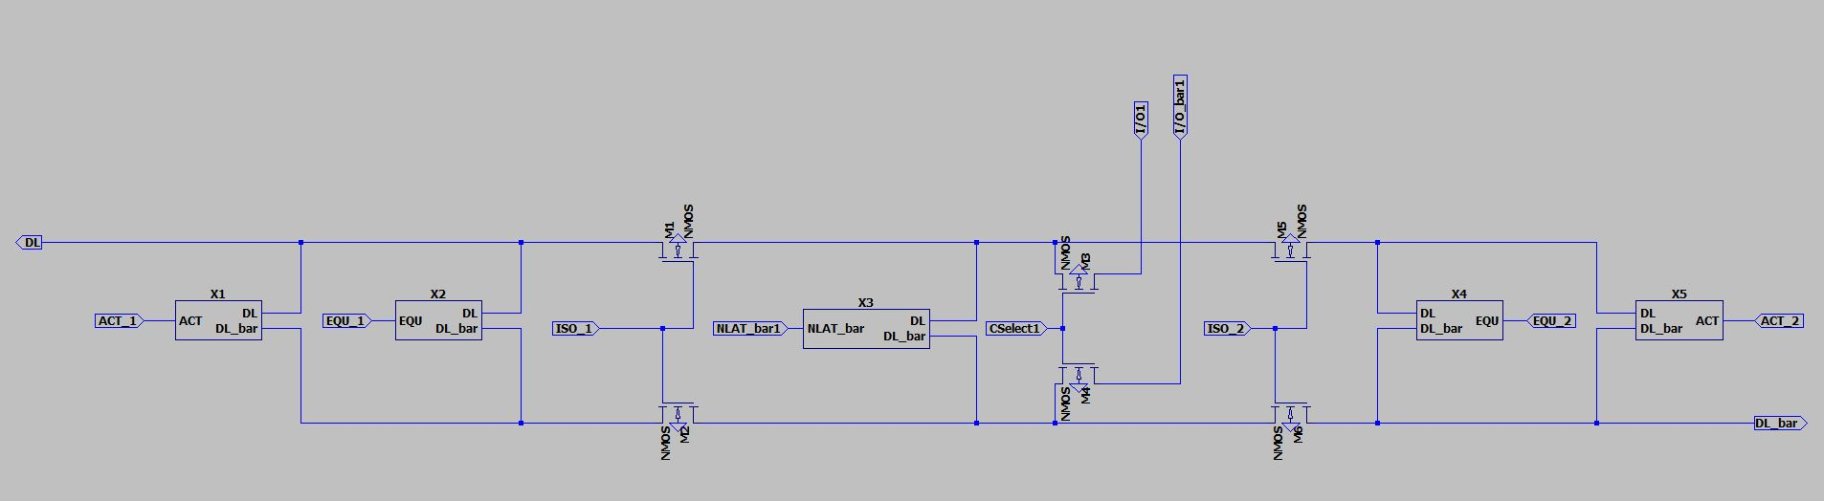
Sense Amplifier

Slide 11
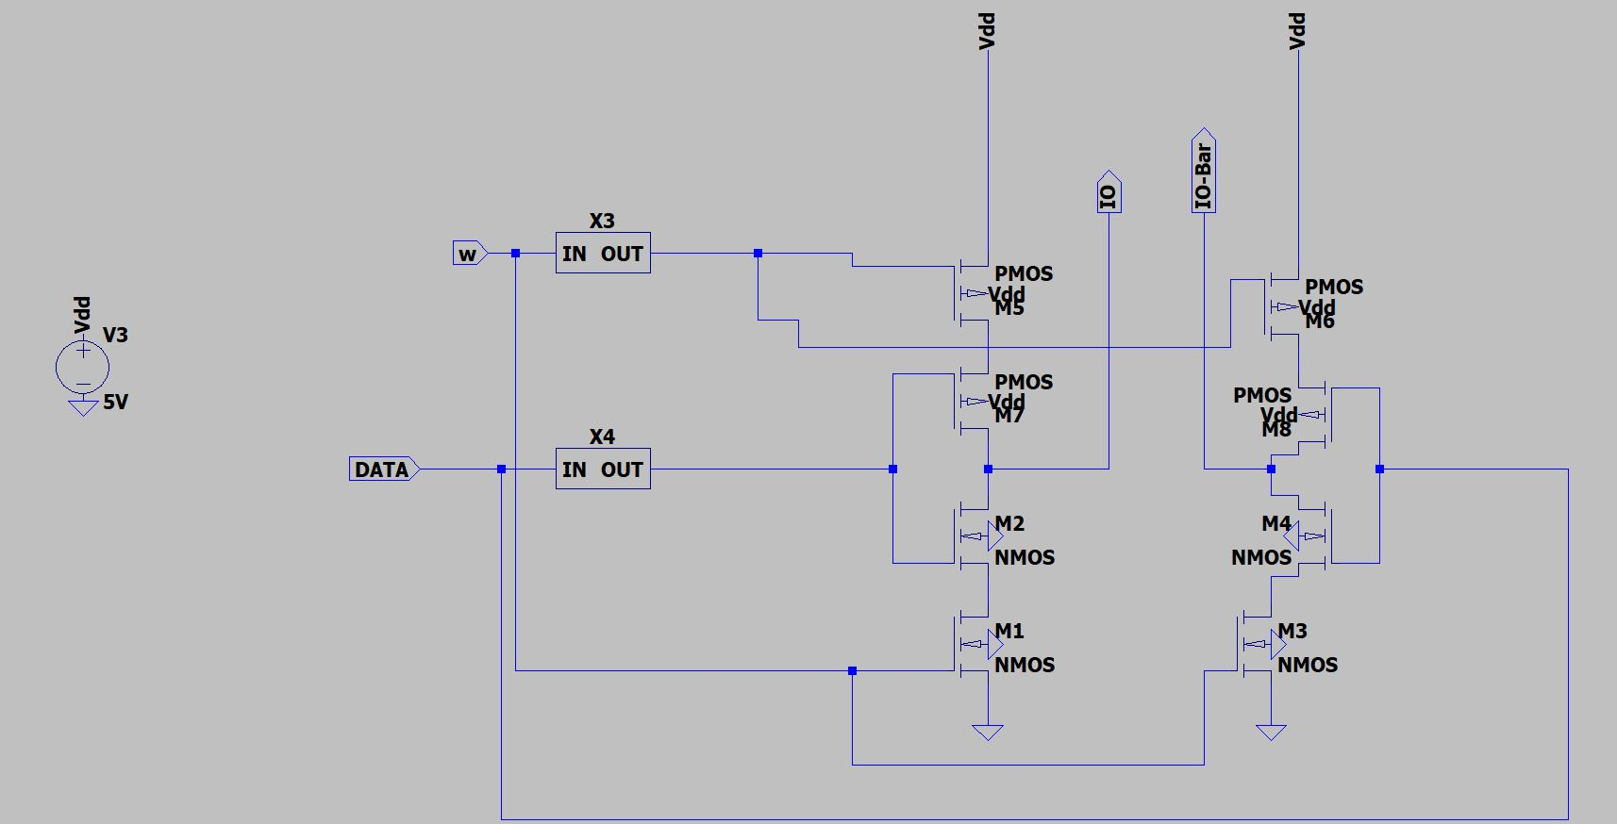
Write Driver
The Write driver circuit it consists gated inverters.
The W signal is used to enable the write operation.
The DATA signal is the value that we wish to store in the cell.

Slide 12
SIMULATION

Slide 13
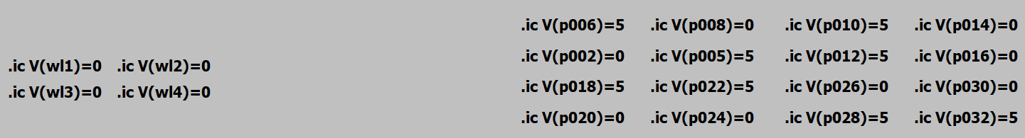
Initial Memory cell values and word line Values
1 | 2 | 3 | 4
1
2
3
4

Slide 14
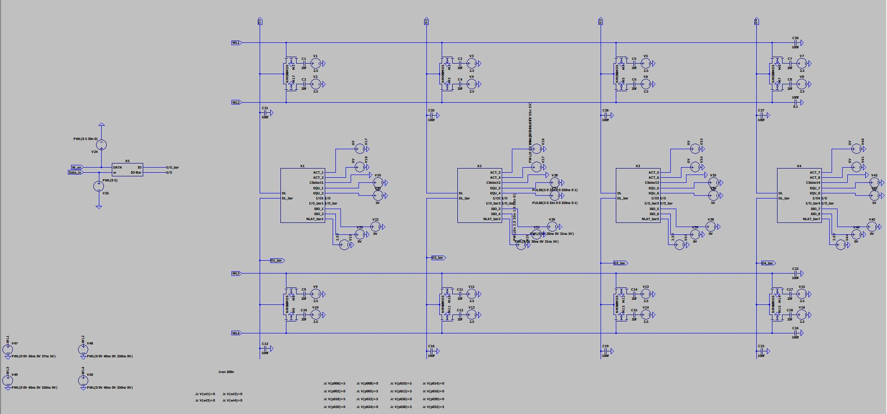
Complete Array

Slide 15
Sequence Of signals
Read Operation
Initially EQU is 5V till 25ns and then it goes to 0(Cselect is 0V throughout).
ISO is 0 till 30ns and the turned on to 5V,therefore removing equilibrate and floating the digit line.
Word line required based on the address is tured on at 35ns(0V to 5V).
ACT also starts increasing slowly from 0 to 5V,and the digit line effected is pulled from 2.5V to 5V,and simultaneously NLAT_bar also goes from 2.5V to 0V slowly, pulling the other digit line from 2.5V to 0V.

Slide 16
Read Operation
Assuming word line 1 to be decoder output and the 2nd column.
The signals of the Sense Amplifier signals are set as presented in the previous slide.
The data from the cell is read and the digit lines change respectively
The change in the digit lines is converted to rail voltage by the Sense Amplifier

Slide 17
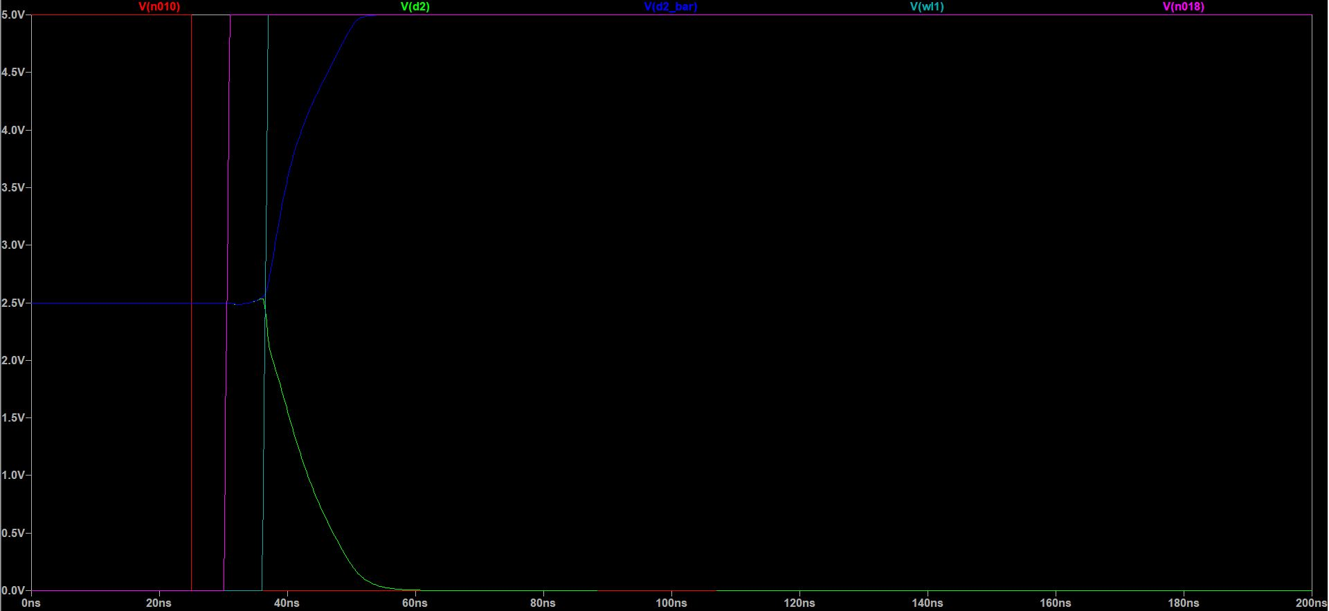
Read Operation
EQU
ISO

Slide 18
Read-Write-Read Operation
Initially EQU is 5V till 25ns and then it goes to 0.
ISO is 0 till 30ns and the turned on to 5V,therefore removing equilibrate and floating the digit line.
Word line required based on the address is turned on at 35ns(0V to 5V).
ACT also starts increasing slowly from 0 to 5V,and the digit line effected is pulled from 2.5V to 5V,and simultaneously NLAT_bar also goes from 2.5V to 0V slowly, pulling the other digit line from 2.5V to 0V.
After this operation the value is the cell is now present on the digit line.

Slide 19
Read-Write-Read Operation
Now Cselect turns on at 65ns.
This will cause the digit lines to change values and overwrite the cell values.
EQU goes high at 110ns(i.e. after write operation) for 25ns pulling the digit lines to 2.5V.
Now EQU goes low so we can read the current value in the cell
Now ISO is turned off and memory returns to initial state.

Slide 20
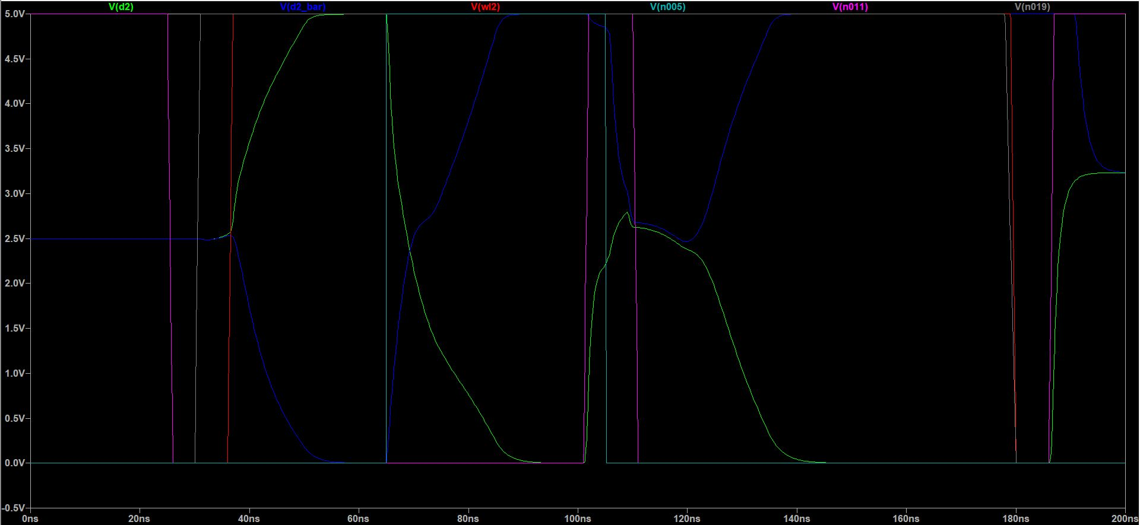
Read-Write-Read Operation
ISO
Cselect
EQU

Slide 21
Thank you

